Slide 2
Java Collection Framework Tài liệu tham khảo

Slide 3
Arrays
array: An object that stores many values of the same type.
element: One value in an array.
index: A 0-based integer to access an element from an array.
length: Number of elements in the array.
index | 0 | 1 | 2 | 3 | 4 | 5 | 6 | 7 | 8 | 9
value | 12 | 49 | -2 | 26 | 5 | 17 | -6 | 84 | 72 | 3
length = 10
element 0
element 4
element 9

Slide 4
Array declaration
type[] name = new type[length];
Length explicitly provided. All elements' values initially 0.
int[] numbers = new int[5];
type[] name = {value, value, … value};
Infers length from number of values provided. Example:
int[] numbers = {12, 49, -2, 26, 5, 17, -6};
index | 0 | 1 | 2 | 3 | 4
value | 0 | 0 | 0 | 0 | 0
index | 0 | 1 | 2 | 3 | 4 | 5 | 6
value | 12 | 49 | -2 | 26 | 5 | 17 | -6

Slide 5
Accessing elements; length
name[index] // access
name[index] = value; // modify
name.length
Legal indexes: between 0 and the array's length - 1.
numbers[3] = 88;
for (int i = 0; i < numbers.length; i++) {
System.out.print(numbers[i] + " ");
}
System.out.println(numbers[-1]); // exception
System.out.println(numbers[7]); // exception
index | 0 | 1 | 2 | 3 | 4 | 5 | 6
value | 12 | 49 | -2 | 88 | 5 | 17 | -6

Slide 6
Limitations of arrays
Arrays are useful, but they have many flaws and limitations:
size cannot be changed after the array has been constructed
no built-in way to print the array
no built-in way to insert/remove an element
no search feature
no sort feature
no easy duplicate detection/removal
inconsistent syntax with other objects (length vs. length() vs. size())
...

Slide 7
Collections
collection: An object that stores data (objects) inside it.
the objects of data stored are called elements
typical operations: add, remove, clear, contains (search), size
some collections maintain an ordering; some allow duplicates
data structure: underlying implementation of a collection's behavior
most collections are based on an array or a set of linked node objects
examples found in the Java class libraries:
ArrayList, LinkedList, HashMap, TreeSet, PriorityQueue
all collections are in the java.util package
import java.util.*;

Slide 8
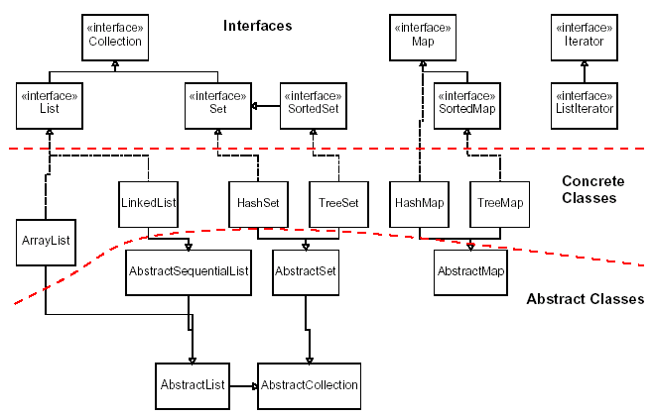
Java collection framework

Slide 9
Abstract data types (ADTs)
abstract data type (ADT): A specification of a collection of data and the operations that can be performed on it.
Describes what a collection does, not how it does it.
Java's collection framework uses interfaces to describe ADTs:
Collection, Deque, List, Map, Queue, Set
An ADT can be implemented in multiple ways by classes:
ArrayList and LinkedList implement List
HashSet and TreeSet implement Set
LinkedList , ArrayDeque, etc. implement Queue

Slide 10
Constructing a collection
Interface<Type> name = new Class<Type>();
Use the ADT interface as the variable type.
Use the specific collection implementation class on the right.
Specify the type of its elements between < and >.
This is called a type parameter or a generic class.
Allows the same ArrayList class to store lists of different types.
List<String> names = new ArrayList<String>();
names.add("Marty Stepp");
names.add("Stuart Reges");

Slide 11
Why use ADTs?
Q: Why would we want more than one kind of list, queue, etc.?
(e.g. Why do we need both ArrayList and LinkedList?)
A: Each implementation is more efficient at certain tasks.
ArrayList is faster for adding/removing at the end; LinkedList is faster for adding/removing at the front/middle.
You choose the optimal implementation for your task, and if the rest of your code is written to use the ADT interfaces, it will work.
Q: Why declare our variables using interface types (e.g. List)?
(e.g. List<String> list = new ArrayList<String>(); )
A: So that the program could be changed to use a different implementation later without needing to change the code much.

Slide 12
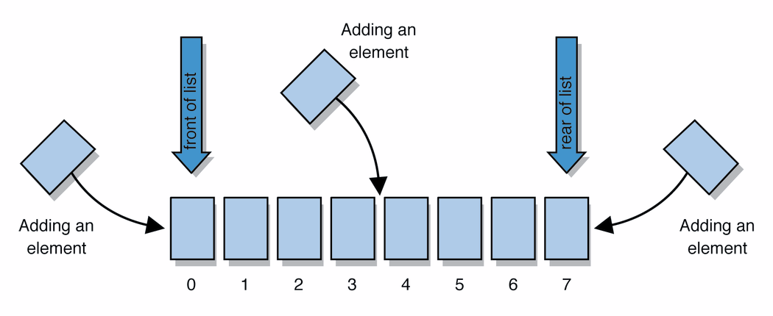
Lists
list: a collection storing an ordered sequence of elements
each element is accessible by a 0-based index
a list has a size (number of elements that have been added)
elements can be added to the front, back, or elsewhere
in Java, represented by the List interface, implemented by the ArrayList and LinkedList classes
Notes:
use jGRASP/DrJava Interactions window to create a list and add some elements, get them, check size

Slide 13
List methods
constructor() constructor(list) | creates a new empty list, or a set based on the elements of another list
add(value) | appends value at end of list
add(index, value) | inserts given value just before the given index, shifting subsequent values to the right
clear() | removes all elements of the list
indexOf(value) | returns first index where given value is found in list (-1 if not found)
get(index) | returns the value at given index
remove(index) | removes/returns value at given index, shifting subsequent values to the left
set(index, value) | replaces value at given index with given value
size() | returns the number of elements in list
toString() | returns a string representation of the list such as "[3, 42, -7, 15]"

Slide 14
List methods 2
addAll(list) addAll(index, list) | adds all elements from the given list to this list (at the end of the list, or inserts them at the given index)
contains(value) | returns true if given value is found somewhere in this list
containsAll(list) | returns true if this list contains every element from given list
equals(list) | returns true if given other list contains the same elements
iterator() listIterator() | returns an object used to examine the contents of the list
lastIndexOf(value) | returns last index value is found in list (-1 if not found)
remove(value) | finds and removes the given value from this list
removeAll(list) | removes any elements found in the given list from this list
retainAll(list) | removes any elements not found in given list from this list
subList(from, to) | returns the sub-portion of the list between indexes from (inclusive) and to (exclusive)
toArray() | returns the elements in this list as an array

Slide 15
List implementation
ArrayList is built using an internal "unfilled" array and a size field to remember how many elements have been added
LinkedList is built using a chain of small "node" objects, one for each element of the data, with a link to a "next" node object
index | 0 | 1 | 2 | 3 | 4 | 5 | 6 | 7 | 8 | 9
value | 42 | -3 | 17 | 0 | 0 | 0 | 0 | 0 | 0 | 0
size | 3
front
size 3
data | next
42
data | next
-3
data | next
17
element 0
element 1
element 2

Slide 16
Stacks and queues
stack: Retrieves elements in the reverse of the order they were added.
queue: Retrieves elements in the same order they were added.
Q: Similar to a list; why do we also have stacks and queues?
A: Sometimes it is good to have a collection that is less powerful, but is optimized to perform certain operations very quickly.
push
pop, peek
top | 3
 | 2
bottom | 1
front |  | back
1 | 2 | 3
remove, peek
add
queue
stack

Slide 17
Class Stack
Stack<Integer> s = new Stack<Integer>();
s.push(42);
s.push(-3);
s.push(17); // bottom [42, -3, 17] top
System.out.println(s.pop()); // 17
Stack<E>() | constructs a new stack with elements of type E
push(value) | places given value on top of stack
pop() | removes top value from stack and returns it; throws EmptyStackException if stack is empty
peek() | returns top value from stack without removing it; throws EmptyStackException if stack is empty
size() | returns number of elements in stack
isEmpty() | returns true if stack has no elements

Slide 18
Interface Queue
Queue<Integer> q = new LinkedList<Integer>();
q.add(42);
q.add(-3);
q.add(17); // front [42, -3, 17] back
System.out.println(q.remove()); // 42
When constructing a queue you must use a new LinkedList object instead of a Queue object.
add(value) | places given value at back of queue
remove() | removes value from front of queue and returns it; throws a NoSuchElementException if queue is empty
peek() | returns front value from queue without removing it; returns null if queue is empty
size() | returns number of elements in queue
isEmpty() | returns true if queue has no elements

Slide 19
Queue idioms
As with stacks, must pull contents out of queue to view them.
// process (and destroy) an entire queue
while (!q.isEmpty()) {
do something with q.remove();
}
another idiom: Examining each element exactly once.
int size = q.size();
for (int i = 0; i < size; i++) {
do something with q.remove();
(including possibly re-adding it to the queue)
}
Notes:
examining each element once is like

Slide 20
Stack/Queue implementation
Stacks are almost always implemented using an array (why?)
Queues are built using a doubly-linked list with a front and back reference, or using an array with front and back indexes (why?)
index | 0 | 1 | 2 | 3 | 4 | 5 | 6 | 7 | 8 | 9
value | 42 | -3 | 17 | 0 | 0 | 0 | 0 | 0 | 0 | 0
size | 3
prev | data | next
 | 42
prev | data | next
 | 42
prev | data | next
 | 42
front
back
size 3

Slide 21
Sets
set: A collection of unique values (no duplicates allowed) that can perform the following operations efficiently:
add, remove, search (contains)
We don't think of a set as having indexes; we just add things to the set in general and don't worry about order.
"the"
"of"
"if"
set.contains("to")
"to"
"down"
"from"
true
"by"
"she"
set.contains("be")
"you"
false
"in"
"why"
"him"
set

Slide 22
Set implementation
in Java, sets are represented by Set interface in java.util
Set is implemented by HashSet and TreeSet classes
HashSet: implemented using a "hash table" array; very fast: constant runtime (O(1)) for all operations elements are stored in unpredictable order
TreeSet: implemented using a "binary search tree"; pretty fast: logarithmic runtime (O(log N)) for all operations elements are stored in sorted order
LinkedHashSet: O(1) but stores in order of insertion

Slide 23
Set methods
List<String> list = new ArrayList<String>();
...
Set<Integer> set = new TreeSet<Integer>(); // empty
Set<String> set2 = new HashSet<String>(list);
constructor() constructor(collection) | creates a new empty set, or a set based on the elements of a collection
add(value) | adds the given value to the set
contains(value) | returns true if the given value is found in this set
remove(value) | removes the given value from the set
clear() | removes all elements of the set
size() | returns the number of elements in list
isEmpty() | returns true if the set's size is 0
toString() | returns a string such as "[3, 42, -7, 15]"

Slide 24
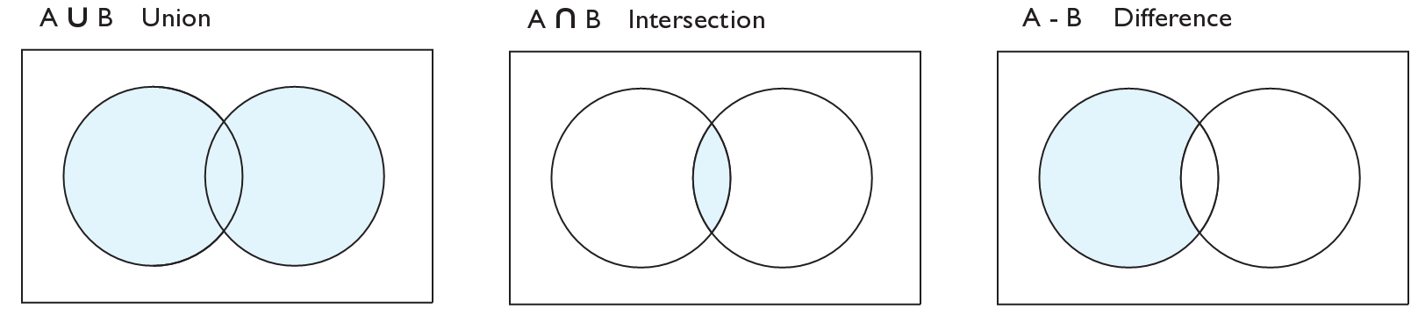
Set operations
addAll
retainAll
removeAll
addAll(collection) | adds all elements from the given collection to this set
containsAll(coll) | returns true if this set contains every element from given set
equals(set) | returns true if given other set contains the same elements
iterator() | returns an object used to examine set's contents (seen later)
removeAll(coll) | removes all elements in the given collection from this set
retainAll(coll) | removes elements not found in given collection from this set
toArray() | returns an array of the elements in this set

Slide 25
Sets and ordering
HashSet : elements are stored in an unpredictable order
Set<String> names = new HashSet<String>();
names.add("Jake");
names.add("Robert");
names.add("Marisa");
names.add("Kasey");
System.out.println(names);
// [Kasey, Robert, Jake, Marisa]
TreeSet : elements are stored in their "natural" sorted order
Set<String> names = new TreeSet<String>();
...
// [Jake, Kasey, Marisa, Robert]
LinkedHashSet : elements stored in order of insertion
Set<String> names = new LinkedHashSet<String>();
...
// [Jake, Robert, Marisa, Kasey]

Slide 26
Comparable
If you want to store objects of your own class in a TreeSet:
Your class must implement the Comparable interface to define a natural ordering function for its objects.
public interface Comparable<E> {
public int compareTo(E other);
}
A call to compareTo must return:
a value < 0 if this object comes "before" the other object,
a value > 0 if this object comes "after" the other object,
or 0 if this object is considered "equal" to the other

Slide 27
The "for each" loop (7.1)
for (type name : collection) {
statements;
}
Provides a clean syntax for looping over the elements of a Set, List, array, or other collection
Set<Double> grades = new HashSet<Double>();
...
for (double grade : grades) {
System.out.println("Student's grade: " + grade);
}
needed because sets have no indexes; can't get element i

Slide 28
Set implementation
TreeSet is implemented using a binary search tree
HashSet is built using a special kind of array called a hash table
root
55
29
87
-3
42
60
91
index | 0 | 1 | 2 | 3 | 4 | 5 | 6 | 7 | 8 | 9
value | 60 | 91 | 42 | -3 | 0 | 55 | 0 | 87 | 0 | 29
size | 7

Slide 29
Priority queue ADT
priority queue: a collection of ordered elements that provides fast access to the minimum (or maximum) element
usually implemented using a tree structure called a heap
priority queue operations:
add adds in order; O(log N) worst
peek returns minimum value; O(1) always
remove removes/returns minimum value; O(log N) worst
isEmpty, clear, size, iterator O(1) always

Slide 30
Java's PriorityQueue class
public class PriorityQueue<E> implements Queue<E>
Queue<String> pq = new PriorityQueue<String>();
pq.add("Stuart");
pq.add("Marty");
...
Method/Constructor | Description | Runtime
PriorityQueue<E>() | constructs new empty queue | O(1)
add(E value) | adds value in sorted order | O(log N )
clear() | removes all elements | O(1)
iterator() | returns iterator over elements | O(1)
peek() | returns minimum element | O(1)
remove() | removes/returns min element | O(log N )

Slide 31
Priority queue ordering
For a priority queue to work, elements must have an ordering
in Java, this means implementing the Comparable interface
many existing types (Integer, String, etc.) already implement this
if you store objects of your own types in a PQ, you must implement it
TreeSet and TreeMap also require Comparable types
public class Foo implements Comparable<Foo> {
…
public int compareTo(Foo other) {
// Return > 0 if this object is > other
// Return < 0 if this object is < other
// Return 0 if this object == other
}
}

Slide 32
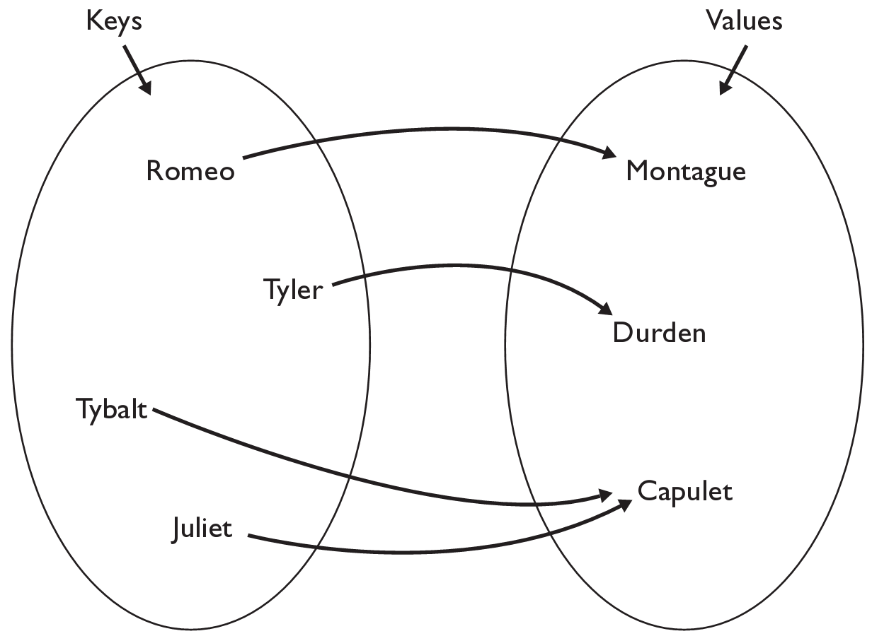
The Map ADT
map: Holds a set of unique keys and a collection of values, where each key is associated with one value.
a.k.a. "dictionary", "associative array", "hash"
basic map operations:
put(key, value): Adds a mapping from a key to a value.
get(key): Retrieves the value mapped to the key.
remove(key): Removes the given key and its mapped value.
myMap.get("Juliet") returns "Capulet"

Slide 33
Map concepts
a map can be thought of as generalization of a tallying array
the "index" (key) doesn't have to be an int
count digits: 22092310907
// (R)epublican, (D)emocrat, (I)ndependent
count votes: "RDDDDRRRRRDDDDDDRDRRIRDRRIRDRRID"
index | 0 | 1 | 2 | 3 | 4 | 5 | 6 | 7 | 8 | 9
value | 3 | 1 | 3 | 0 | 0 | 0 | 0 | 1 | 0 | 2
"R"
14
key | "R" | "D" | "I"
value | 15 | 14 | 3
"D"
3
"I"
15
keys
values

Slide 34
Map implementation
in Java, maps are represented by Map interface in java.util
Map is implemented by the HashMap and TreeMap classes
HashMap: implemented using an array called a "hash table"; extremely fast: O(1) ; keys are stored in unpredictable order
TreeMap: implemented as a linked "binary tree" structure; very fast: O(log N) ; keys are stored in sorted order
A map requires 2 type parameters: one for keys, one for values.
// maps from String keys to Integer values
Map<String, Integer> votes = new HashMap<String, Integer>();

Slide 35
Map methods
put(key, value) | adds a mapping from the given key to the given value; if the key already exists, replaces its value with the given one
get(key) | returns the value mapped to the given key (null if not found)
containsKey(key) | returns true if the map contains a mapping for the given key
remove(key) | removes any existing mapping for the given key
clear() | removes all key/value pairs from the map
size() | returns the number of key/value pairs in the map
isEmpty() | returns true if the map's size is 0
toString() | returns a string such as "{a=90, d=60, c=70}"
keySet() | returns a set of all keys in the map
values() | returns a collection of all values in the map
putAll(map) | adds all key/value pairs from the given map to this map
equals(map) | returns true if given map has the same mappings as this one

Slide 36
Using maps
A map allows you to get from one half of a pair to the other.
Remembers one piece of information about every index (key).
Later, we can supply only the key and get back the related value:
Allows us to ask: What is Joe's phone number?
// key value
put("Joe", "206-685-2181")
Map
get("Joe")
Map
"206-685-2181"

Slide 37
Maps vs. sets
A set is like a map from elements to boolean values.
Set: Is Joe found in the set? (true/false)
Map: What is Joe's phone number?
"Joe"
Set
true
false
"Joe"
Map
"206-685-2181"

Slide 38
keySet and values
keySet method returns Set of all keys in map
can loop over the keys in a foreach loop
can get each key's associated value by calling get on the map
Map<String, Integer> ages = new TreeMap<String, Integer>();
ages.put("Joe", 57);
ages.put("Geneva", 2); // ages.keySet() returns Set<String>
ages.put("Vicki", 19);
for (String name : ages.keySet()) { // Geneva -> 2
int age = ages.get(name); // Joe -> 57
System.out.println(name + " -> " + age); // Vicki -> 19
}
values method returns Collection of all values in map
ages.values() above returns [2, 57, 19]
can loop over the values with a for-each loop
no easy way to get from a value back to its associated key(s)

Slide 39
Collections summary
It is important to be able to choose a collection properly based on the capabilities needed and constraints of the problem to solve.
collection | ordering | benefits | weaknesses
array | by index | fast; simple | little functionality; cannot resize
ArrayList | by insertion, by index | random access; fast to modify at end | slow to modify in middle/front
LinkedList | by insertion, by index | fast to modify at both ends | poor random access
TreeSet | sorted order | sorted; O(log N) | must be comparable
HashSet | unpredictable | very fast; O(1) | unordered
LinkedHashSet | order of insertion | very fast; O(1) | uses extra memory
TreeMap | sorted order | sorted; O(log N) | must be comparable
HashMap | unpredictable | very fast; O(1) | unordered
LinkedHashMap | order of insertion | very fast; O(1) | uses extra memory
PriorityQueue | natural/comparable | fast ordered access | must be comparable

Slide 40
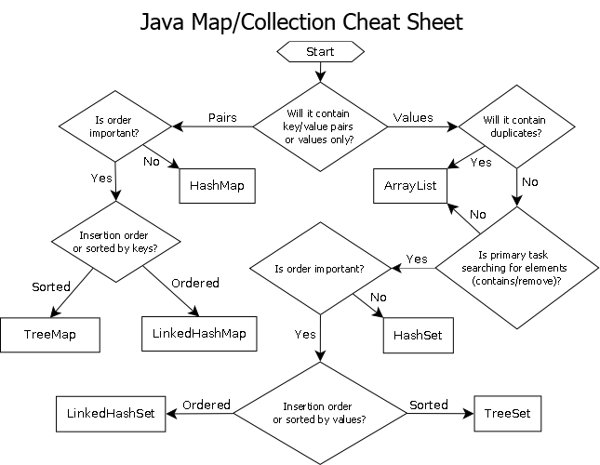
Choosing a collection
see also: http://initbinder.com/bunker/wp-content/uploads/2011/03/collections.png

Slide 41
Compound collections
You will often find that you want a collection of collections:
a list of lists; a map of strings to lists; a queue of sets; ...
Example: how would you store people's friends?
i.e., I need to quickly look up the names of all of Jimmy's buddies, or test whether a given person is a friend of Jimmy's or not.
// don't forget to initialize each Set of friends
Map<String, Set<String>> pals =
new HashMap<String, Set<String>>();
pals.put("Jimmy", new HashSet<String>());
pals.get("Jimmy").add("Bill");
pals.get("Jimmy").add("Katherine");
pals.get("Jimmy").add("Stuart");

Slide 42
Iterators (11.1)
iterator: An object that allows a client to traverse the elements of any collection.
Remembers a position, and lets you:
get the element at that position
advance to the next position
remove the element at that position
index | 0 | 1 | 2 | 3 | 4 | 5 | 6 | 7 | 8 | 9
value | 3 | 8 | 9 | 7 | 5 | 12 | 0 | 0 | 0 | 0
size | 6
"the"
list
set
"to"
"we"
"from"
current element: 9
current index: 2
current element: "from"
next element: "the"
iterator
iterator

Slide 43
Iterator methods
Iterator interface in java.util
every collection has an iterator() method that returns an iterator over its elements
Set<String> set = new HashSet<String>();
...
Iterator<String> itr = set.iterator();
...
hasNext() | returns true if there are more elements to examine
next() | returns the next element from the collection (throws a NoSuchElementException if there are none left to examine)
remove() | removes the last value returned by next() (throws an IllegalStateException if you haven't called next() yet)

Slide 44
Iterator example
Set<Integer> scores = new TreeSet<Integer>();
scores.add(94);
scores.add(38); // Jenny
scores.add(87);
scores.add(43); // Marty
scores.add(72);
...
Iterator<Integer> itr = scores.iterator();
while (itr.hasNext()) {
int score = itr.next();
System.out.println("The score is " + score);
// eliminate any failing grades
if (score < 60) {
itr.remove();
}
}
System.out.println(scores); // [72, 87, 94]

Slide 45
A surprising example
What's bad about this code?
List<Integer> list = new LinkedList<Integer>();
... (add lots of elements) ...
for (int i = 0; i < list.size(); i++) {
System.out.println(list.get(i));
}
front =
data | next
42
data | next
-3
data | next
17
element 0
element 1
element 2

Slide 46
Iterators and linked lists
Iterators are particularly useful with linked lists.
The previous code is O(N²) because each call on get must start from the beginning of the list and walk to index i.
Using an iterator, the same code is O(N). The iterator remembers its position and doesn't start over each time.
front =
data | next
42
data | next
-3
data | next
17
element 0
element 1
element 2
current element: -3
current index: 1
iterator

Slide 47
ListIterator
ListIterator<String> li = myList.listIterator();
lists have a more powerful ListIterator with more methods
can iterate forwards or backwards
can add/set element values (efficient for linked lists)
add(value) | inserts an element just after the iterator's position
hasPrevious() | true if there are more elements before the iterator
nextIndex() | the index of the element that would be returned the next time next is called on the iterator
previousIndex() | the index of the element that would be returned the next time previous is called on the iterator
previous() | returns the element before the iterator (throws a NoSuchElementException if there are none)
set(value) | replaces the element last returned by next or previous with the given value

